Slide 1
Teachers Know Their Content And Teach Effectively: CAEP Standard 1
Stevie Chepko, CAEP
Sr. VP for Accreditation

Slide 2
Standard 1 -
The provider ensures that candidates develop a deep understanding of the critical concepts and principles of their discipline and, by completion, are able to use discipline-specific practices flexibly to advance the learning of all students toward attainment of college- and career- readiness standards.
  Requires the disaggregation of candidate data by specialty licensure area (critical concepts and principles of their discipline)
  Commitment to the learning of all students (D)
  Commitment to college- and career- readiness standards.

Slide 3
The Self Study – Standard 1
Self Studies CI/TI/IB for Standard 1
  Evidence would be submitted by Standard for CI/TI process or by Claims in IB process
  All evidence and data specific to the Standard is embedded in the report
  Only evidence supporting the Standard is submitted
  Attachment A –
    All EPP created assessments submitted in Attachment A (including scoring guides where applicable)
    List of proprietary assessments with validity, reliability information, when taken, and justification for selection
    (Pending approval by the Accreditation Council and the CAEP Board)

Slide 4
The Self Study – Standard 1(cont)
  Attachment B
    Complete data charts for all assessments
    All data disaggregated by specialty licensure area
    Data chart conventions are followed
  Reviewers’ comparisons
    Specialists in assessment and data analysis review Attachments A and B
      Determine if the feedback provided during the three-year-out review was incorporated into assessments
      Determine if data supports conclusions from the self-study report
      On-site the team verify the conclusions
  (Pending approval by the Accreditation Council and the CAEP Board)

Slide 5
Submission of Self Study – Standard 1
Self-study is submitted by Standard or Claims
  Specialty area evidence submitted as part of CAEP Standard 1
  Data submitted as evidence for CAEP Standard 1 is embedded into the narrative text of the report
  Only evidence specific to components of Standard 1 is submitted –
    EPPs submit only data specific to the component
    Requires EPPs to disaggregate data from data charts specific to that component
    Evidence based case is made for meeting Standard 1
Pending approval by the Accreditation Council and the CAEP Board)

Slide 6
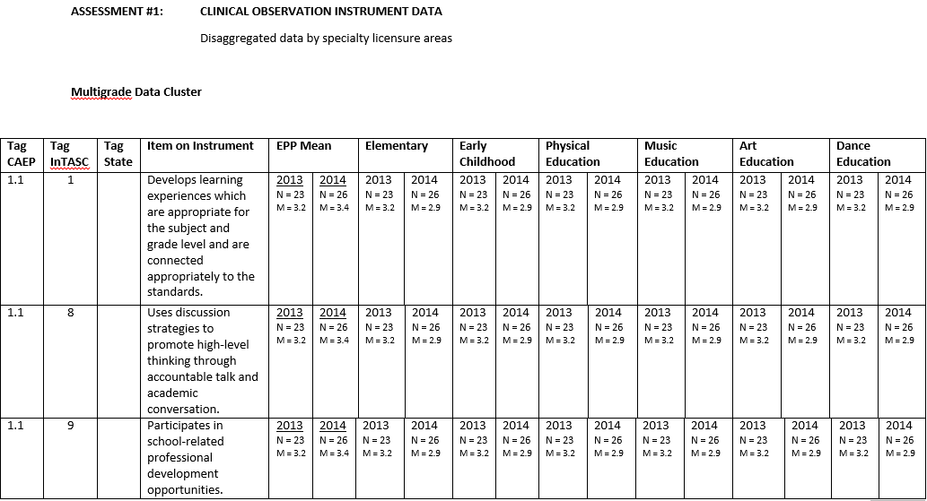
Sample Data Chart

Slide 7
Submission of Self Study – Standard 1 (cont.)
By Standard Evidence
  Each component should be addressed (1.1 – 1.5) and data supporting each component are embedded in text
  Threads of diversity and technology also addressed
  After data are reported in Standard 1, the same data are referenced in supporting of other standards (not represented or repeated, but referenced)
  Most candidate based data are reported in Standard 1
  Prompts or questions will be provided to aid EPPs in organizing their answers and data
(Pending approval by the Accreditation Council and the CAEP Board)

Slide 8
Parts of Self Study – Standard 1
Narrative to include
  Context in which assessments are used
    When and where assessment occurs
    Any other relevant contextual factors
  Present the case for meeting the components
    By assessment present the “evidence” that the component is met embedded in text
    Validity/trustworthiness or reliability/consistency evidence is submitted with the actual assessments in Attach B and referenced for evidence for Standard 5
  Discuss results and reach conclusions
  Summary – make the case for the meeting of the Standard
(Pending approval by the Accreditation Council and the CAEP Board)

Slide 9
Standard 1 – Component 1.1
1.1 Candidates demonstrate an understanding of the 10 InTASC standards at the appropriate progression level(s)[i] in the following categories: the learner and learning; content; instructional practice; and professional responsibility.
  Must provide evidence for each category of InTASC Standards
    Learner and Learning
    Content
    Instructional practice
    Professional responsibility
  Do Not have to address each of the 10 InTASC Standards just provide evidence in each category
  (Pending approval by the Accreditation Council and the CAEP Board)

Slide 10
Standard 1 – Component 1.1 (cont.)
Types of evidence for the learner and learning
  Clinical Experience Observational Instrument
  Lesson and/or unit plans
  Portfolios – specific portion dedicated to learner and learning
  Teacher Work Sample
  Content Knowledge Licensure Test (sub-scores)
  Pedagogical Content Licensure Test
  GPA
    Courses listed specific to the learner and learning
    Content specific methods courses that have learner development embedded into the coursework
  (Pending approval by the Accreditation Council and the CAEP Board)
Types of evidence for Content

Slide 11
Sample chart

Slide 12
Standard 1 – Component 1.1
Types of evidence for Content Knowledge
  Content Knowledge Licensure Test
  Clinical Experience Observational Instrument with items specific to the application of content knowledge
  Lesson and/or unit plans
  GPA
    Courses listed specific to content knowledge
    Data chart to include mean GPA for education majors and non-majors in the same course(s)
    Data disaggregated by specialty licensure area
  Pending approval by the Accreditation Council and the CAEP Board)

Slide 13
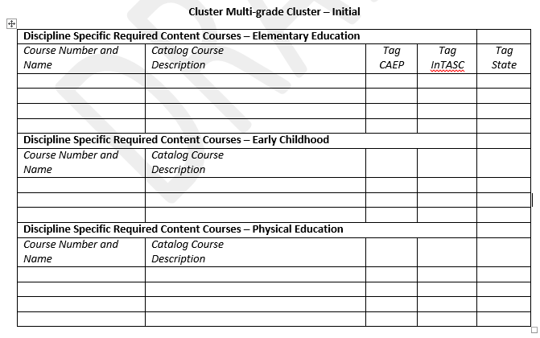
Required Course - Sample Submission Chart

Slide 14
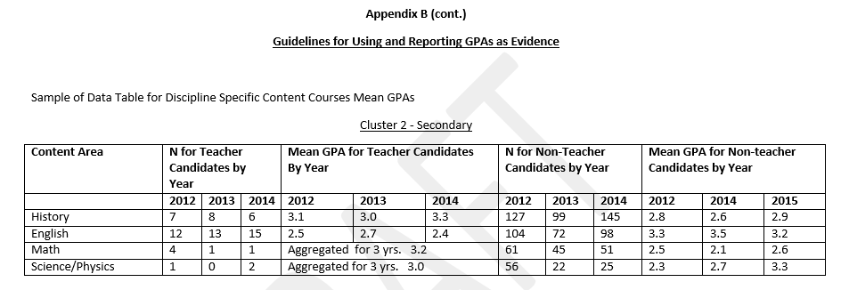
GPA Content – Sample Data Chart

Slide 15
Standard 1 – Component 1.1 (cont.)
Types of evidence for Instructional Practice
  Assessment
    Teacher Work sample
    Impact of student learning instruments
    Portfolios
    Lesson and/or unit plans
  Planning for Instruction
    Lesson and/or unit plans
    Portfolios
    Work Samples
  (Pending approval by the Accreditation Council and the CAEP Board)

Slide 16
Standard 1 – Component 1.1 (cont.)
Types of evidence for Instructional Practice
  Instructional Strategies
    Clinical Observation Instruments
    Lesson and/or unit plans
    Portfolios
    Focus teaching experiences
    Video analyzes
Types of evidence for Professional Responsibility
  Dispositional instruments
  Professional Development data
  Clinical Observational Instruments
  (Pending approval by the Accreditation Council and the CAEP Board)

Slide 17
Standard 1 – Component 1.2
1.2 Providers ensure that completers use research and evidence to develop an understanding of the teaching profession and use both to measure their P-12 students’ progress and their own professional practice.
Types of evidence for Component 1.2
  Portfolio
  Reflections or narratives
  Work Samples
  Pre & Post data
Demonstrates use of data for instructional decision-making; research evidence is cited in narratives (e.g., edTPA, PPAT, reflections, or portfolios)
  Criteria identified and expectations defined
  (Pending approval by the Accreditation Council and the CAEP Board)

Slide 18
Standard 1 – Component 1.3
1.3 Providers ensure that completers (candidates near completion) apply content and pedagogical knowledge as reflected in outcome assessments in response to standards of Specialized Professional Associations (SPA), the National Board for Professional Teaching Standards (NBPTS), states, or other accrediting bodies (e.g., National Association of Schools of Music – NASM).
Types of evidence for Component 1.3
  SPA Program Reports
  Alignment with state standards
  Evidence of meeting specific state requirements (i.e. anti-bullying training, etc.)
  National Board for Professional Teaching Standards
  (Pending approval by the Accreditation Council and the CAEP Board)

Slide 19
Standard 1 – Component 1.4
1.4 Providers ensure that completers (candidates near completion) demonstrate skills and commitment that afford all P-12 students access to rigorous college- and career-ready standards (e.g., Next Generation Science Standards, National Career Readiness Certificate, Common Core State Standards).
Types of evidence for Component 1.4
  Clinical Experience Observational Instruments
  Lesson and/or unit plans
  Portfolios
  Focus teaching experiences
  Video analyzes
  (Pending approval by the Accreditation Council and the CAEP Board)

Slide 20
Standard 1 – Component 1.4 (cont.)
Phase-in Applies
  Curricular alignment: Evidence of short and long-term changes to scope and sequencing of curriculum/modules that prepare candidates to teach college and career readiness standards effectively.
  Assessment curriculum inputs to promote candidates’ assessment proficiencies (1) course work focused on assessment, (2) embedded assessment topics in content and methods courses, and (3) providing candidates real-world opportunities to apply what they have learned about assessment.
  (Pending approval by the Accreditation Council and the CAEP Board)

Slide 21
Standard 1 – Component 1.4 (cont.)
Address specifically
  ELA Standards
    Regular practice with complex text & academic standards
    Reading, writing, & speaking grounded in evidence from texts, both literary and informational
    Building knowledge through content-rich nonfiction
  Math Standards
    Focus and master fewer topics
      Concepts
      Skills
      Problem solving
  (Pending approval by the Accreditation Council and the CAEP Board)

Slide 22
Standard 1 – Component 1.4 (cont.)
Phase-in for Component 1.4 could include the following –
  Assessment & audit of program to determine alignment to college and career readiness standards
  Short and long term changes to scope and sequencing of curriculum/modules
  Professional development for teacher educators/clinical educators on college and career readiness standards
  New and revised assessments of candidate performance
    Engage all students in critical thinking activities, cogent reasoning and evidence collection
    (Pending approval by the Accreditation Council and the CAEP Board)

Slide 23
Standard 1 – Component 1.4 (cont.)
Demonstrate the following –
  Engage all students in critical thinking activities, cogent reasoning, and evidence collection
  Assess P-12 student mastery of multiple standards, checking for student learning
  Analyze and interpret student data
  Use assessment and student data to differentiate learning
  (Pending approval by the Accreditation Council and the CAEP Board)

Slide 24
Standard 1 – Component 1.4 (cont.)
  New and revised assessments of candidate performance (cont.)
    Assess student mastery of multiple standards & checking for student learning (cross-disciplinary instruction)
    Analyze and interpret student data
    Use of assessment and student data to differentiate instruction
    (Pending approval by the Accreditation Council and the CAEP Board)

Slide 25
Standard 1 – Component 1.5
1.5 Providers ensure that completers (candidates near completion) model and apply technology standards as they design, implement and assess learning experiences to engage students and improve learning; and enrich professional practice.
Types of evidence for 1.5
  Clinical Experience Observational Instrument
  Lesson and/or Unit plans
  Portfolio
  Teacher Work Sample with evidence of application and use of technology
  Technology Key Assessment
  (Pending approval by the Accreditation Council and the CAEP Board)

Slide 26
Standard 1 – Component 1.5 (cont.)
Tips for Component 1.5
  Technology standards such as ISTE are aligned with assessments
  Students involved in use of technology
  Technology aligned with goals/objectives of lesson/unit
  Technology used to differentiate instruction
  Technology enhances the lesson
  Technology used to collect data or gather information
  (Pending approval by the Accreditation Council and the CAEP Board)

Slide 27
Self Study – Standard 1
After addressing each component of the Standard, present the summary case for having met the Standard based on the evidence
  Cite the data specifically when making the case
  Provide specific examples on how data were used to make program or EPP level changes
  Identify both strengths and areas for improvement based on evidence
  Guiding questions and prompts will be provided
  (Pending approval by the Accreditation Council and the CAEP Board)

Slide 28
Self Study – Specialty Area Data
At the end of Standard 1 –
  Separate section specific to the disaggregated data by specialty licensure area
  EPPs will address and answer specific questions on how the disaggregated data by specialty licensure area informed EPP and program area decisions
    For the Program Review with Feedback option, EPPs will address how the evidence aligned with the identified state standards and provided evidence for the meeting of the standards
    For SPA options, EPPs will address how the SPA reports informed EPP and specialty licensure area decisions
  (Pending approval by the Accreditation Council and the CAEP Board)

Slide 29
Self Study – Specialty Licensure Area Data (cont.)
Questions to be addressed –
  How have the results of specialty licensure area evidence been used to inform decision making and improve instruction and student learning outcomes?
  What has been learned about different specialty licensure areas as a result of the review of the disaggregated data?
  (Pending approval by the Accreditation Council and the CAEP Board)

